Slide 1
Digital Wireless Communications Waveforms and Protocols
Common Modulation Waveforms
ASK (Amplitude Shift Keying)
FSK (Frequency Shift Keying)
PSK (Phase Shift Keying)
QAM (Quadrature Amplitude Modulation)
OFDM (Orthogonal Frequency Division Multiplex)
Common Amateur Protocols
CW (very basic ASK)
RTTY (FSK)
FT4/FT8 (FSK)
C4FM (FSK)
PACTOR 1/2/3/4
VARA, OLIVIA
K1VX September 2021

Slide 2
Many things happen to an electromagnetic wave after it is launched from your antenna
All of them are bad, especially for digital decoding
Goal is to design for maximum throughput using minimum resources
Audio/video can usually “cover up” some errors
Data or executable code need to be 100% accurate -- requires more complex error detection/correction and mechanism for re-transmission (ARQ)

Slide 3
Metrics for Digital Comm Systems
For Amateur, it’s Bits/Hz: How much data can be transferred in a given bandwidth under realistic channel conditions
At HF, the ionosphere is an unstable, unpredictable reflector
Important for narrowband systems (ham, private/public safety)
For public (cellular systems) it’s Bits/Hz/Area
How many customers can I serve in my licensed bandwidth in a given area
Maximize Frequency Re-use
3G and 4G cellular networks re-use frequencies in every sector of every site
Important to keep customers happy and stay in business
Shannon Limit: the “Holy Grail”
C: bits/sec, B: Hz

Slide 4
Extra Class Exam Pool Question E8C02
What is the definition of symbol rate in a digital transmission?
A. The number of control characters in a message packet
B. The duration of each bit in a message sent over the air
C. The rate at which the waveform of a transmitted signal changes to convey information
D. The number of characters carried per second by the station-to-station link
C “Waveform” consists of frequency, phase, amplitude, or some combination – on one or more synchronized carriers
More combinations => more bits per symbol, but higher Signal-to-Noise Ratio (SNR) is needed to distinguish between them in the decoder
“Symbol” = “Baud”

Slide 5
Sidebar: Digital Voice Coder
Narrowband digital voice usually (always?) uses Digital Voice Systems (DVSI) proprietary Advanced Multi-Band Excitation (AMBE©) voice coder.
Converts a voice bandwidth analog signal to ~3600 bits/sec data stream.
Models human speech and vocal tract
Horrible for music, worse for data
Packed into frames for transport over a data path
Voice (or video) frames must be processed on time and in order (an issue over the Internet) to “play.” Jitter buffer and “cover-up” mechanisms.
Noticeably lower quality than broadband coders used in cellular networks, but “good enough”
Degrades significantly if coded more than once (analog -> digital -> analog -> digital -> analog)
P25 avoids this wherever possible

Slide 6
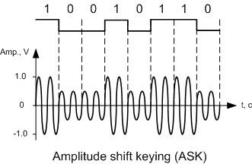
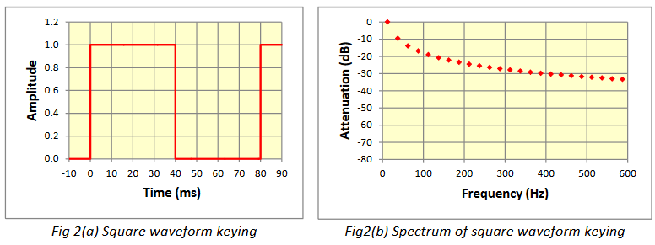
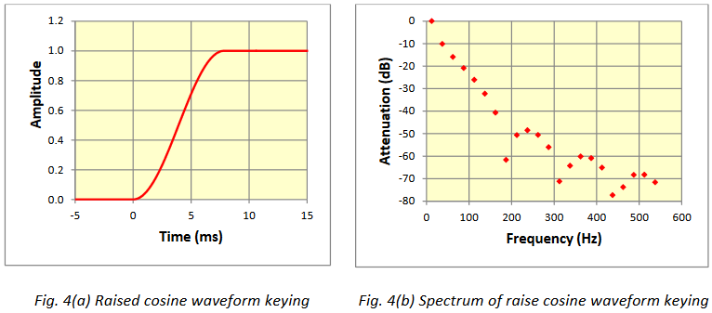
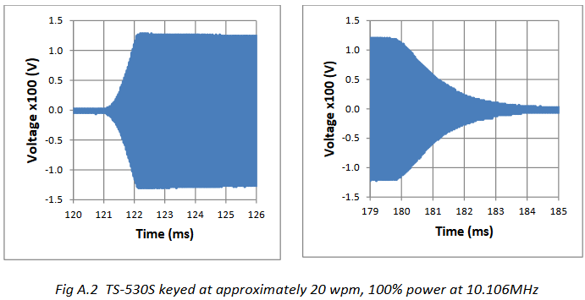
Amplitude Shift Keying (ASK)
CW (on-off keying) is the most basic form of ASK
Notes:
More to come on this : QAM

Slide 7
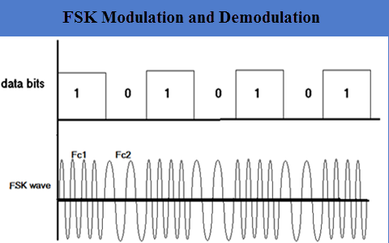
Frequency Shift Keying (FSK)
Shift among two or more frequencies for each symbol
“single carrier” with constant amplitude
Can avoid phase discontinuities at symbol boundaries
RTTY
170 / 850 Hz frequency shift
45.45 baud (symbols/sec), synchronized to legacy Teletype machine mechanics
5 bits/character (32 possible combinations) Baudot, Ltrs/Figs shift, no lower case
Very old protocol, easy to “decode” with two audio passband L-C filters
Very spectrally inefficient
WSPR/FT4/FT8
WSPR: one of 4 tones, 1.4648 baud, spaced 1.4648 Hz apart, 6Hz BW
FT4: 20.833... baud, one of 4 tones spaced 23.4 Hz apart, 90 Hz BW
FT8: 6.25 baud, one of 8 tones spaced 6.25 Hz apart, 50 Hz BW
Frequency transitions smoothed in Guassian filter to minimize occupied bandwidth
4FSK/C4FM (Fusion, DMR, P25)
Each symbol is one of 4 frequencies, 31.25 symbols/second => 9600 bps
OLIVIA (HF)
Each symbol is one of 32 frequencies, 4800 symbols/second => 9600 bps
Adaptive, supports 2^{n} up to 256 tones, FEC coding
GMSK (D-Star, GSM cellular)

Slide 8
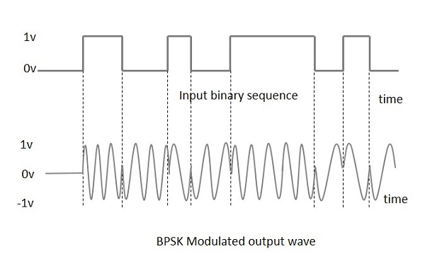
Phase Shift Keying (PSK)
Phase of the carrier assigned for each symbol
BPSK (binary phase shift keying): 1 bit per symbol
QPSK (quadrature phase shift keying): 2 bits per symbol
8PSK (8-phase shift keying): 3 bits per symbol . . .
Phase discontinuities increase occupied bandwidth -- filtering (commonly root-raised cosine) is applied to minimize bandwidth
PSK31: 31.25 baud (symbols/sec), BPSK or QPSK
BPK or QPSK, symbol amplitude is shaped as sine function to reduce occupied bandwidth
BW ~ 60 Hz
“Varicode” – shorter bit patterns assigned to more common characters
Up to 10 bits represent the entire 128 ASCII characters

Slide 9
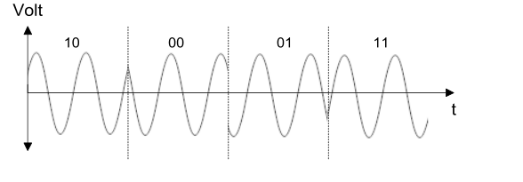
Quadrature Phase Shift Keying (QPSK)
Waveform: I and Q inputs are 90 degrees out of phase. Each is multiplied by its data (1=1; 0=-1). Add them together. “Signal” will be filtered before transmission.
Constellation Diagram:
QPSK with Gray Coding
Adjacent symbols vary by only 1 bit – minimizes bit errors and facilitates error correction
MSK144 is a form of “Offset QPSK” optimized for Meteor Scatter.
2K baud, 1KHz freq offset. Input data stream is offset by ½ symbol between I and Q channels.

Slide 10
QAM (Quadrature Amplitude Modulation)
Two inputs in Quadrature (90° out of phase), each amplitude (ASK) modulated with a portion of the bits being transported by the symbol.
Add them together, producing an amplitude and phase modulated waveform.
Most common formats:
MOD Bits/Symbol Possible Values
16-QAM 4 16
64-QAM 6 64
256-QAM 8 256
Higher SNR is required to decode higher-level modulation
Constellation can be square or concentric
Fourier Transform used to separate magnitude of I and Q phases and match it to a set of bits

Slide 11
OFDM (Orthogonal Frequency Division Multiplex)
Multi-carrier technology
Peak-to-average power ratio (PAPR) is much higher than single carrier
Require higher power, more linearity in power amplifier
Allows more bits to be transported at a given symbol rate
Can be used to comply with our archaic FCC “baud rate” limit
Processed by Fast Fourier Transform (FFT) to extract amplitude and phase for each subcarrier
Side note: a 10 MHz 4G LTE OFDM downlink channel is composed of 600 subcarriers, each of which can be BPSK, QPSK, 16-QAM, 64-QAM. Symbol rate is 15 kHz. Decoded by 1024-point FFT. Uplink channel is converted (via inverse FFT) to single-carrier (SC-FDMA) to make life easier on the mobile transmitter (and its battery)

Slide 12
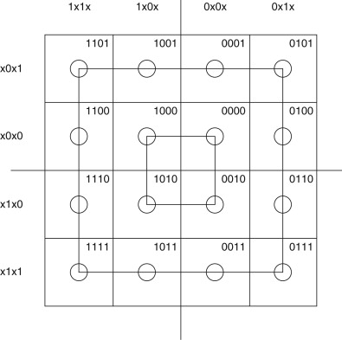
16-QAM: Concentric or Square Constellation

Slide 13
16-QAM Square Constellation
As the SNR decreases, the constellation degrades and the likelihood of an error increases.
Gray Code: adjacent points differ by only one bit, minimizing bit errors when the wrong point is chosen. Facilitates error correction.

Slide 14
Common Amateur VHF/UHF Digital Voice Protocols

Slide 15
Other Common HF Digital Protocols
Protocol | Speed (bps, physical) max | Modulation Type | Symbols per sec | Application / Notes
PACTOR 1 | 100-200 | FSK (2-tone, 200 Hz spacing) | 100 | Data/email, Automatic Repeat Request, (ARQ), 16-bit CRC “Long-haul” option (extends ARQ timing)
PACTOR 2 | 100-700 | 16PSK, 200 Hz spacing | 100 | Data/email (ARQ), 1/2 – 7/8 rate coding
PACTOR 3 | 200-3600 | BPSK, QPSK 2-18 tones | 100 | Data/email (ARQ) Adaptive, 6 speed levels, propagation-dependent
PACTOR 4 | 9000 | FSK, QPSK, 8PSK, 16QAM, 32QAM | 1800 | Data/email (ARQ) Not legal in US due to symbol rate > 300
VARA | 8489 | FSK, QPSK, 8PSK, 16QAM, 32QAM 3-59 carriers | 37.5 | Data/email
OLIVIA | ~ 6000 | FSK (4-32 tones), 31.25 Hz spacing | 31.25 - 125 | ASCII, FEC (forward error correction)
DRM | 4.5K-72K | OFDM, 88-460 carriers |  | 4.5-20 kHz channel BC audio, AAC coding
Notes:
HF skywave propagation is a horrible path for data, particularly phase response across channel.
PACTOR protocols adapt modulation and FEC coding to channel conditions to maximize throughput
Pactor 2, 3, and 4 are proprietary to SCS GmbH
Pactor 4 exceeds the 300 baud limit imposed by FCC, but is legal in much of the world.

Slide 16
Thoughts on “DSP” in Amateur Radios
Introduced about 30 years ago for Audio and Low-IF processing
Noise reduction / Notch filters
Flexible filtering
Transmit audio compression
Most ham radios still use superhet front end with some low
frequency digital processing
Direct-sampling amateur radios have appeared in recent years
High performance Analog-to-Digital Converters (ADC) and Field Programmable Gate Arrays (FPGA) arrived!
Directly samples the amplified antenna input (e.g. the whole HF spectrum, VHF, low UHF) with minimal filtering ahead of the ADC, passing samples directly into the FPGA for Digital Down-Conversion, Filtering, Detection, etc.
ICOM 7300, 7610, 9700, Elecraft K4, Flex, Apache ANAN (open source)
May use under-sampling or block down-converters for higher frequencies
ICOM 9700: direct sampling at 196.608 Msps (49.152 MHz x4) for 2M, UHF (undersampling), block downconverter to 311-371 MHz for 1.2 GHz band; Tx Digital-to-Analog Converter (DAC) sample rate is 1179.648 MHz (49.152 MHz x 24).
Performance is mostly determined by ADC and clock “jitter”
Clock is single-frequency, so cleaner than typical VFO (synthesizer)
“Gain” doesn’t drop at higher multiples of Fs, provided that input BW of ADC is adequate
Some (e.g., Yaesu FT-10) use direct sampling only for spectrum scope, superhet for signal processing
Superhet is adequate for most amateur narrowband purposes, though fully-digital does add flexibility and some possibilities
Pre-distortion for very clean transmitter performance
Some have dual Rx inputs to enable diversity

Slide 17
ICOM 9700 Block Diagram

